Slide 1
When easy is not preferred: A discounting paradigm to assess load-independent task preference
Josephine Zerna
Differential and Personality Psychology, TU Dresden
Registered Report
Zerna, J.*, Scheffel, C.*, Kührt, C., & Strobel, A.
Pre-Data Talk, DGPs Congress Hildesheim 2022

Slide 2
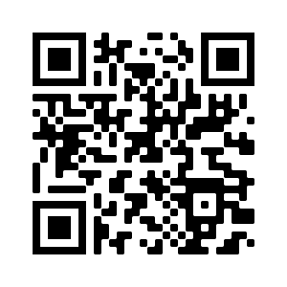
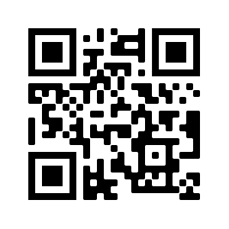



Outline
Motivation: Effort findings and the COG-ED Paradigm
The CAD Paradigm: Taking objective load out of the equation
Analyses & Specification Curve Analysis
Questions & Discussion
Stage 1 Registered Report
at Nature Scientific Reports

Slide 3
I. Motivation
When choosing between emotion regulation strategies, subjective effort is more important than the strategies’ effectiveness (Scheffel et al., 2021)
But: We still know very little about how each choice option is valued
→ Cognitive Effort Discounting Paradigm (COG-ED) by Westbrook et al. 2013

Slide 4
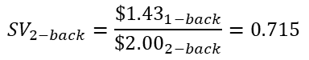
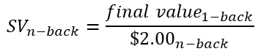
I. Motivation – The COG-ED Paradigm by Westbrook et al. 2013
Five pairings:
1-back vs. 2-back
1-back vs. 3-back
1-back vs. 4-back
1-back vs. 5-back
1-back vs. 6-back
Subjective values:
$${SV}_{n−back}=\frac{{final value}_{1−back}}{{\$2.00}_{n−back}}$$
$${SV}_{2−back}=\frac{{\$1.43}_{1−back}}{{\$2.00}_{2−back}}=0.715$$

Slide 5
I. Motivation – The COG-ED Paradigm by Westbrook et al. 2013
SV_{n} = the minimum relative reward required for me to choose 1-back over n-back, thereby forgoing the higher reward for n-back
Subjective values:
$${SV}_{n−back}=\frac{{final value}_{1−back}}{{\$2.00}_{n−back}}$$
But what if someone does not prefer the easiest level?
$${SV}_{2−back}=\frac{{\$1.43}_{1−back}}{{\$2.00}_{2−back}}=0.715$$

Slide 6
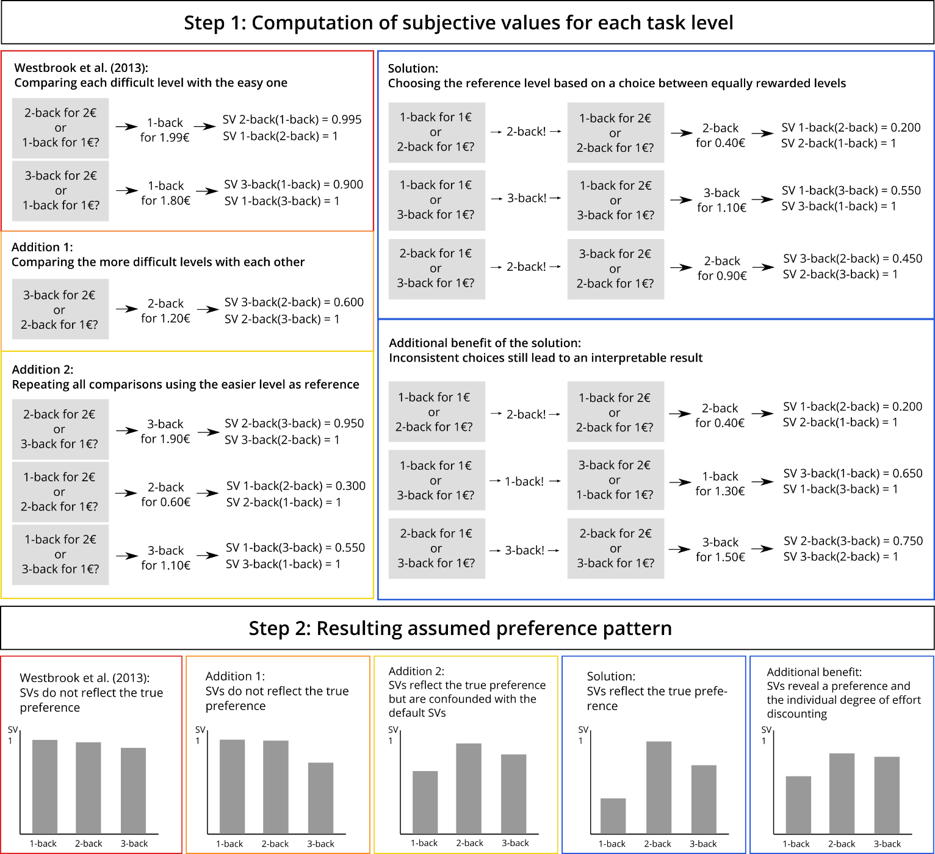
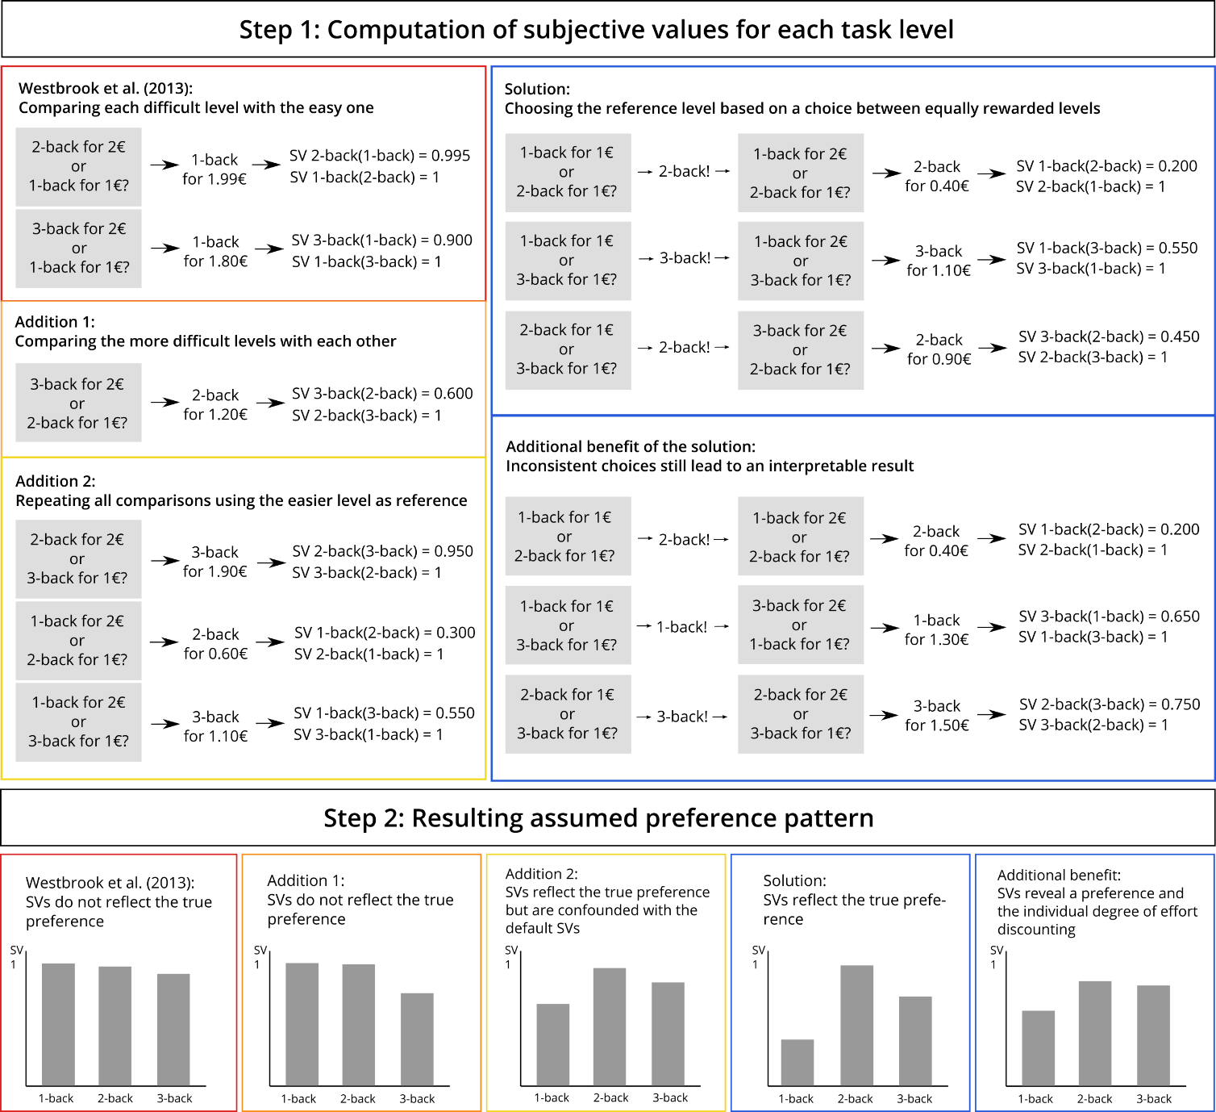
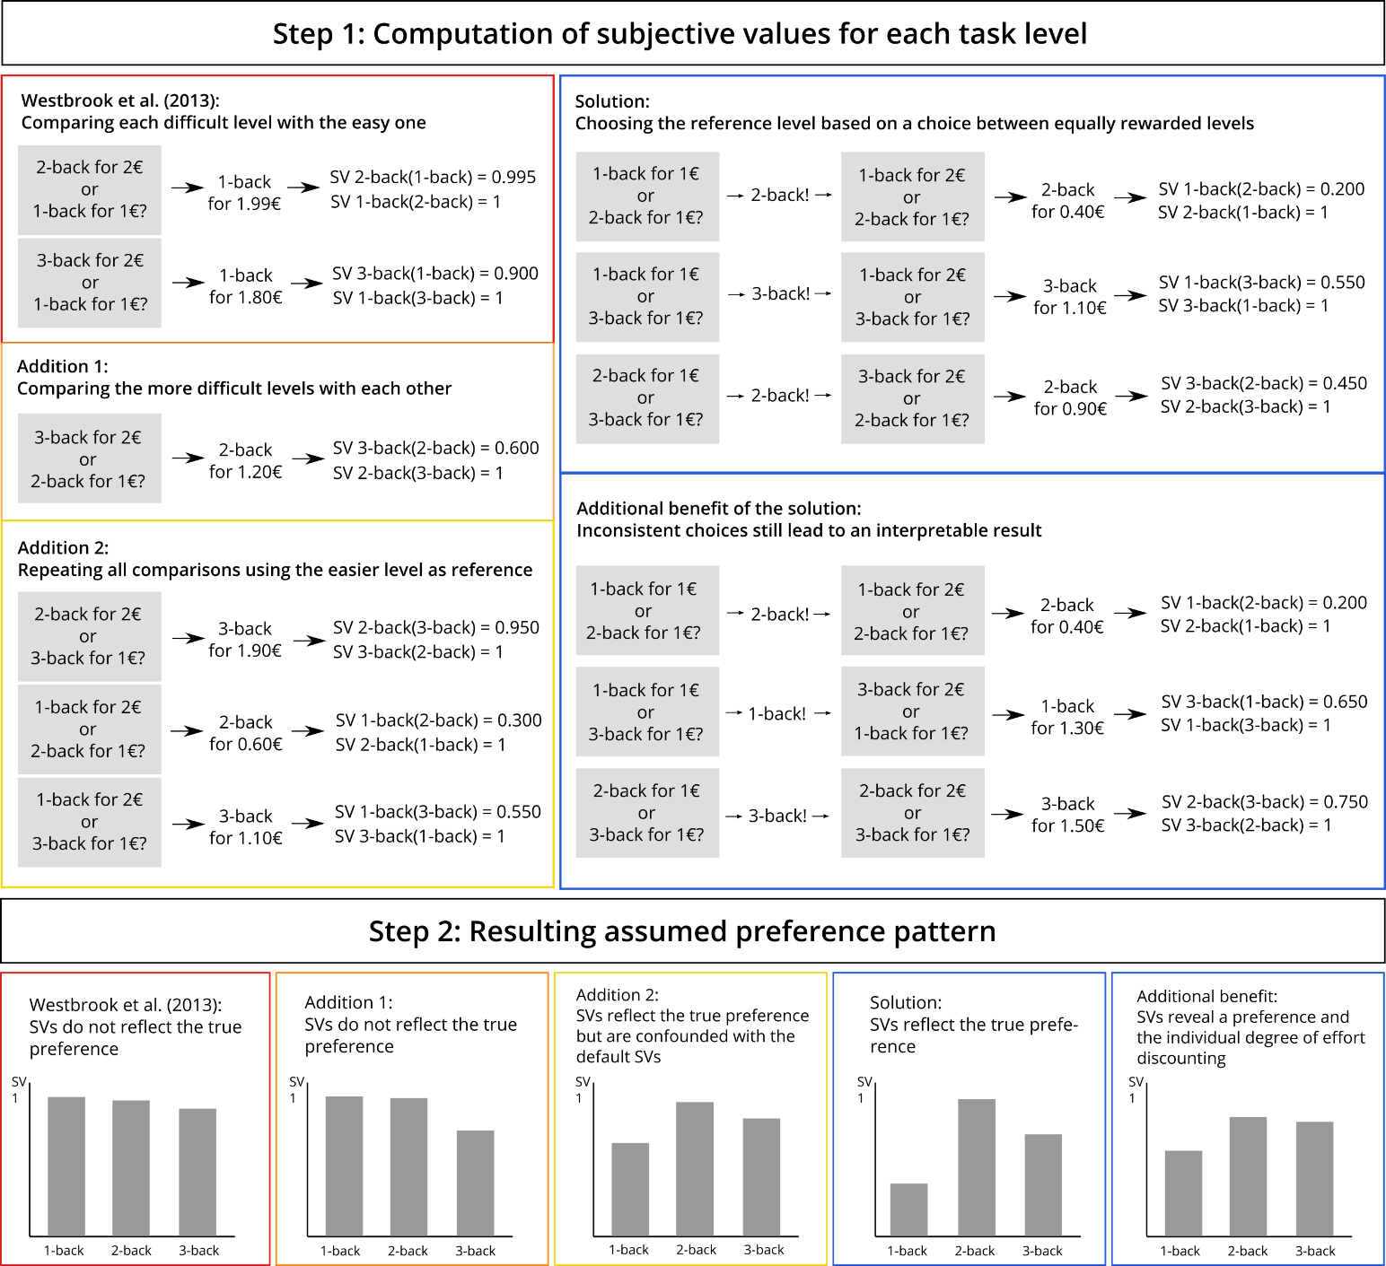
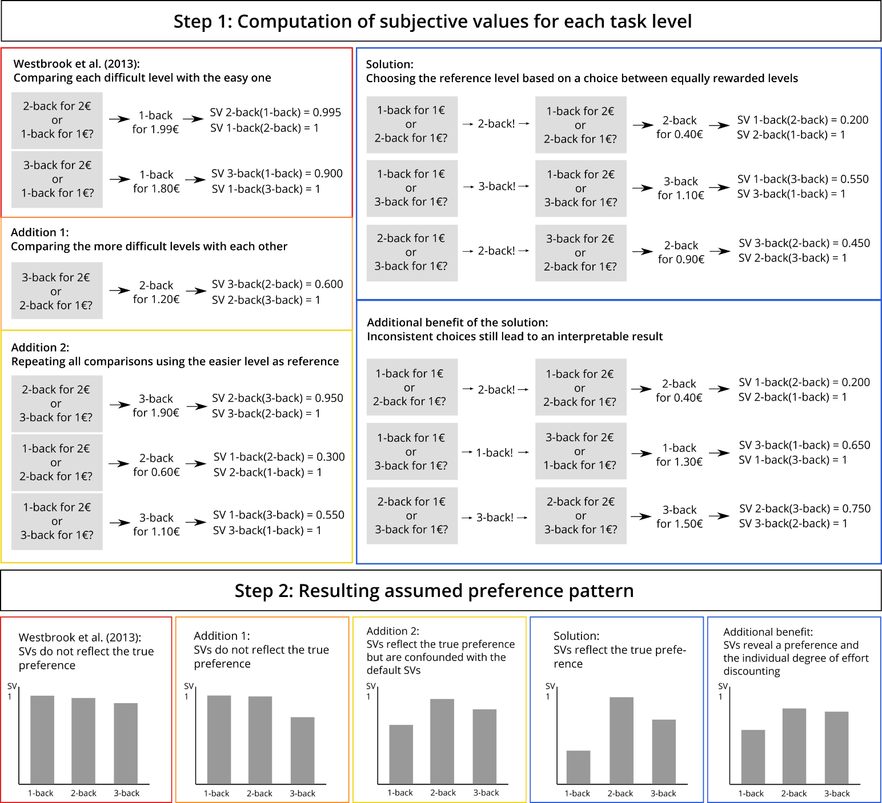
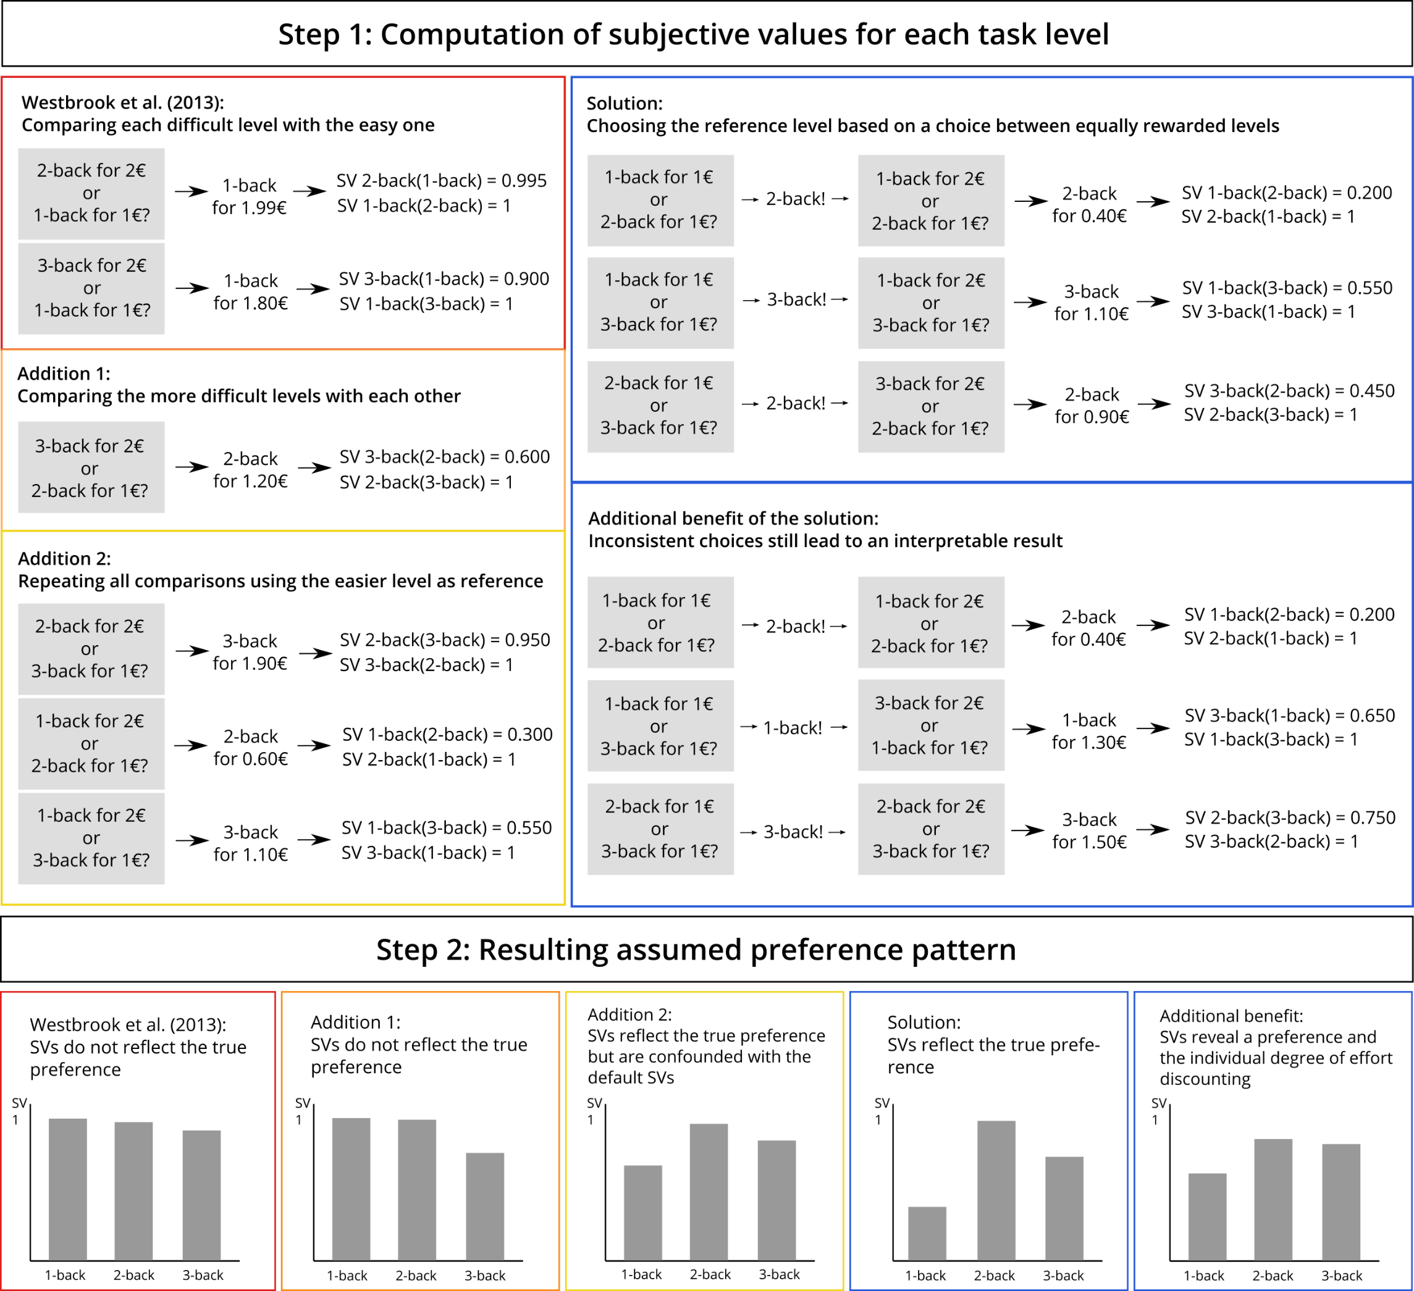
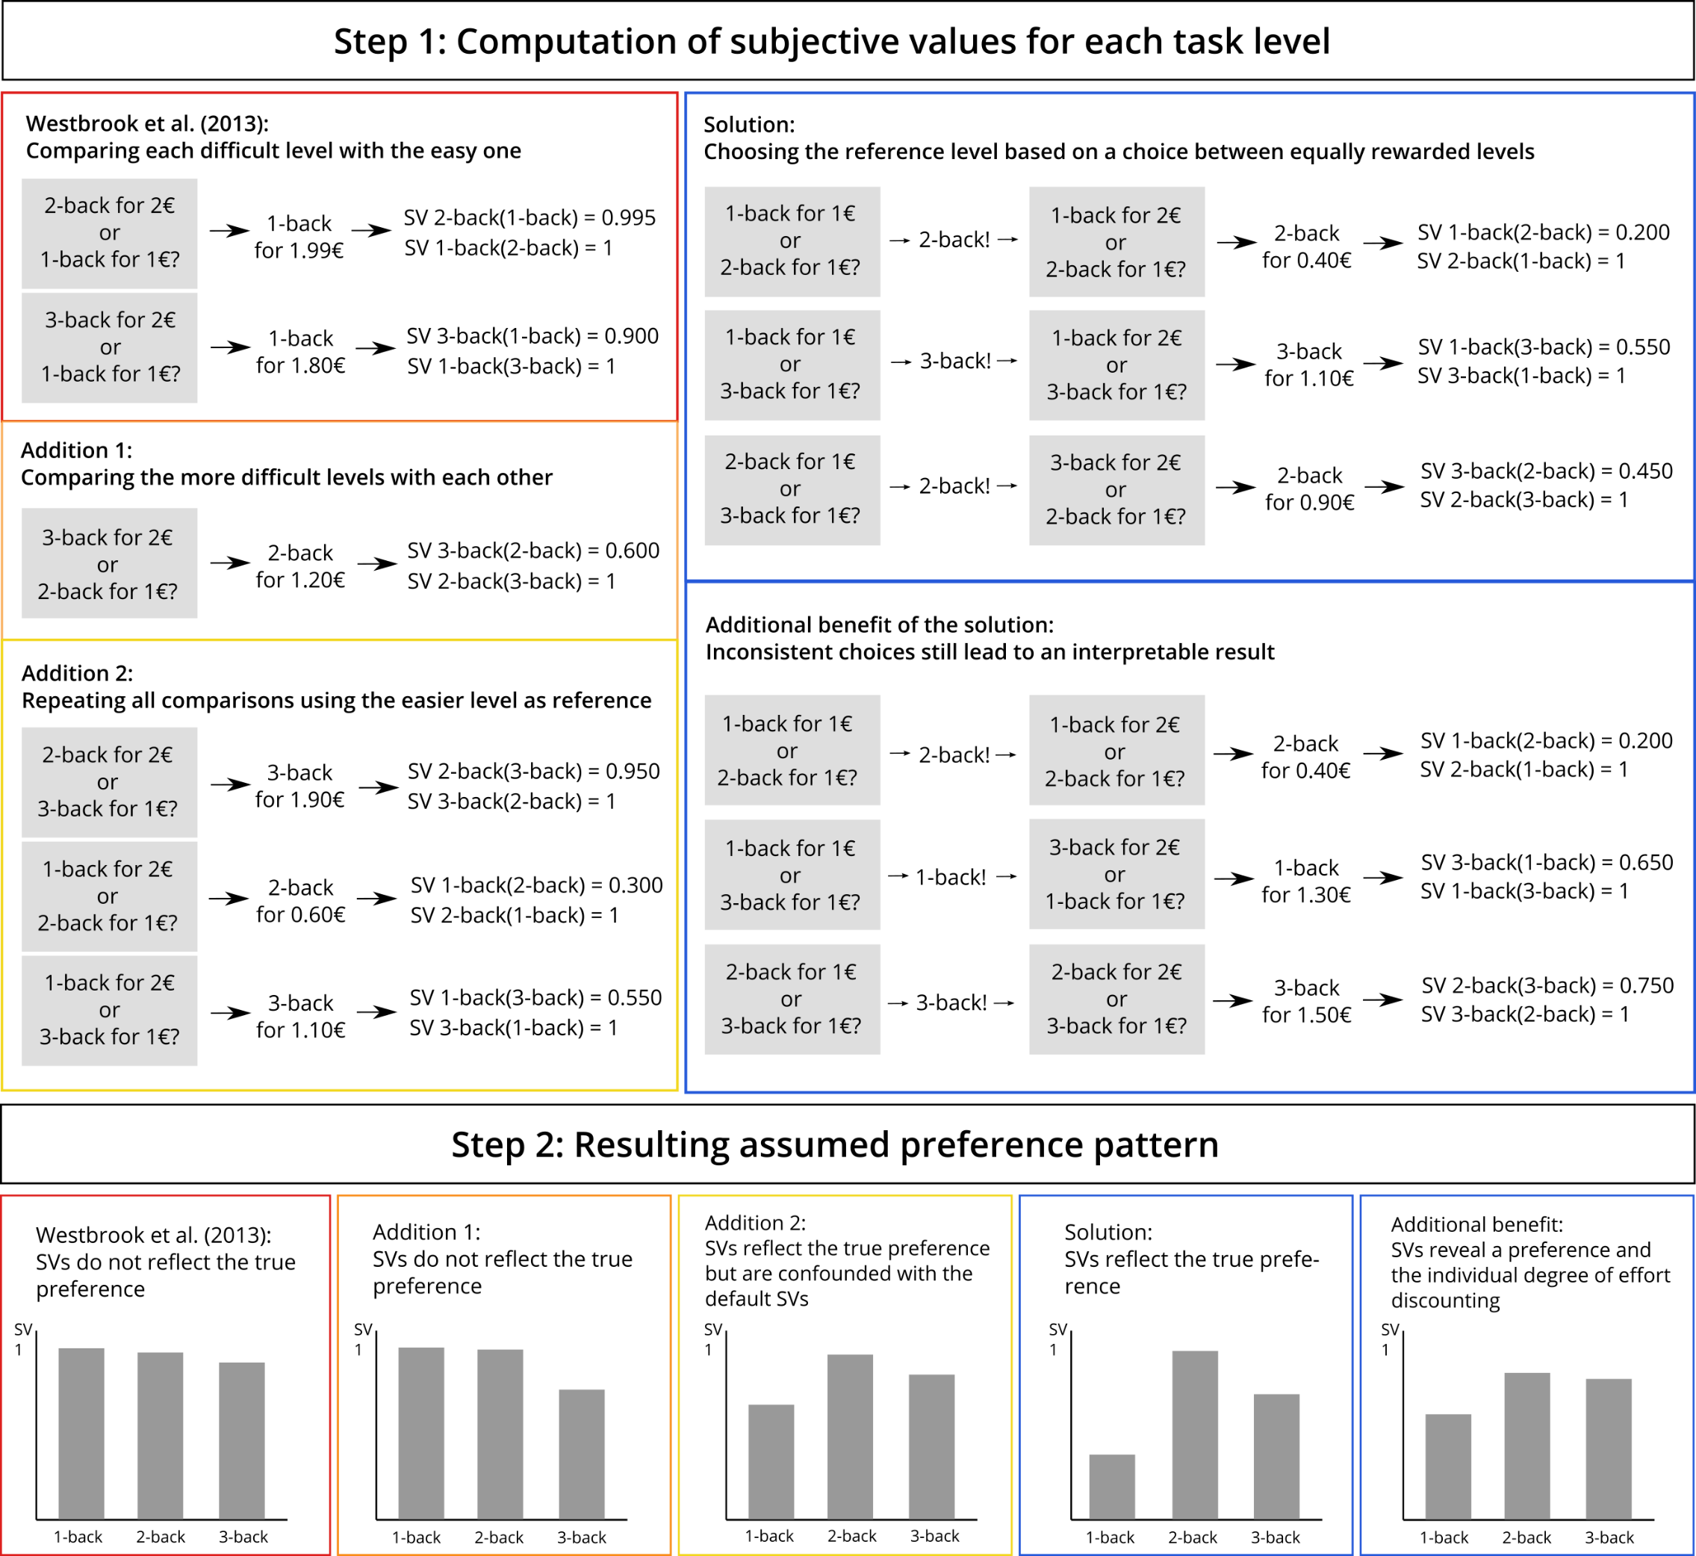
II. The Cognitive Affective Discounting (CAD) Paradigm
Hypothetical subjective values of a participant with the preference 2-back > 3-back >1-back

Slide 7
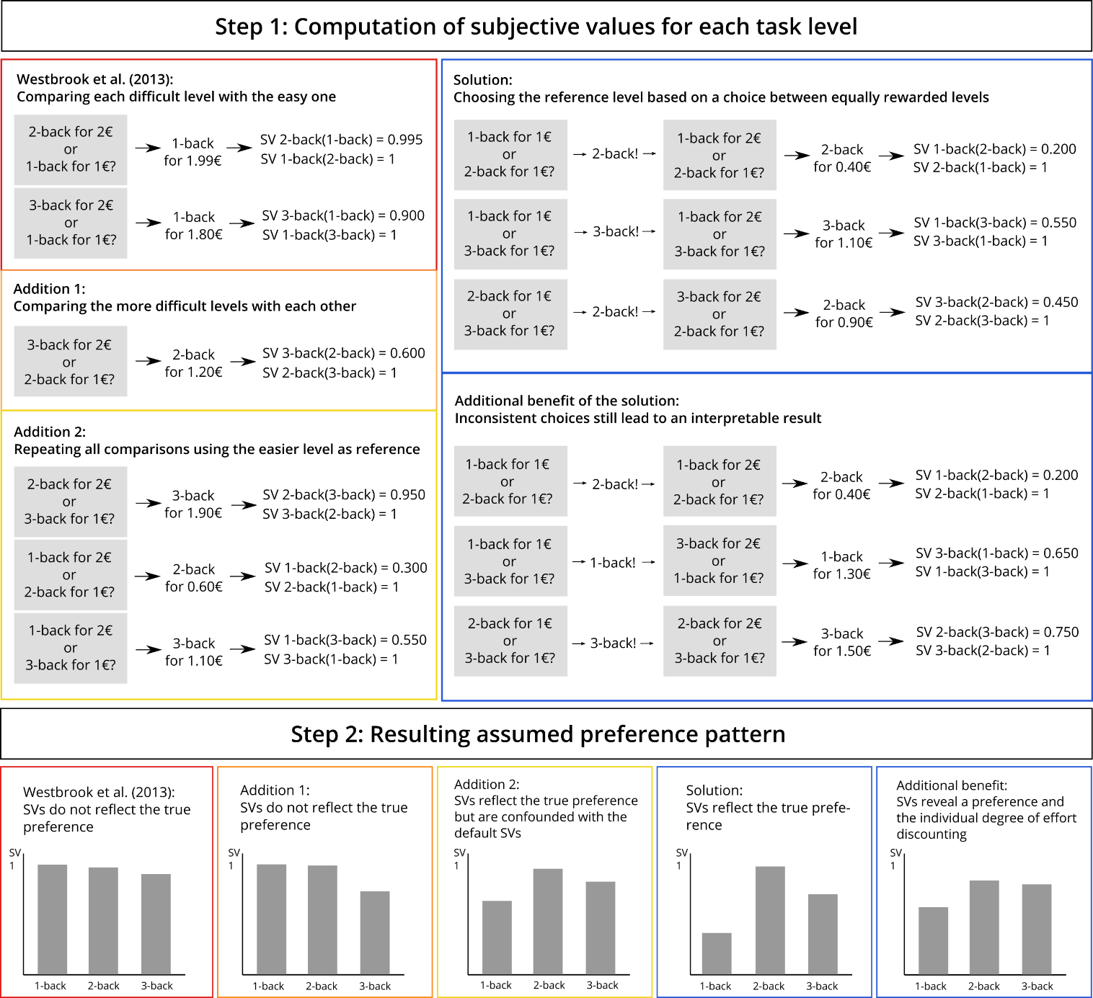
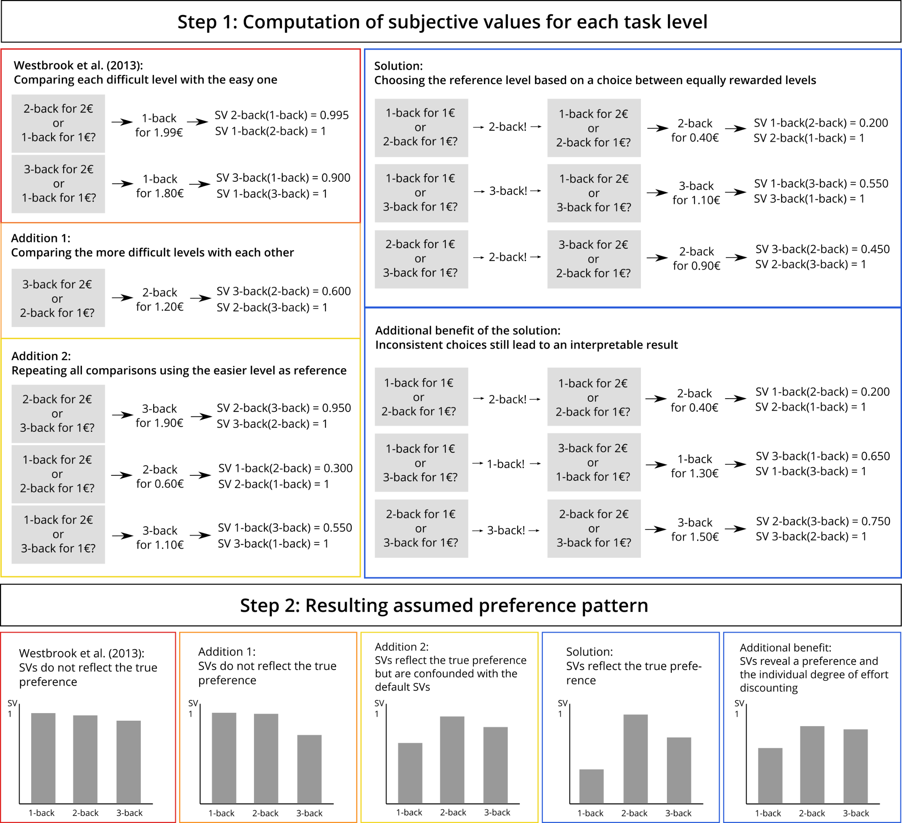
II. The Cognitive Affective Discounting (CAD) Paradigm
Hypothetical subjective values of a participant with the preference 2-back > 3-back >1-back
In case of inconsistent choices

Slide 8
III. Analyses and Specification Curve Analysis
Study Design:
Personality questionnaires (online)
Need for Cognition
Self-Control
Emotion Regulation
…
Lab session 1
n-back Task with n = 1 to n = 4
CAD Paradigm
One randomly chosen n-back level
Lab session 2 (one week later)
Emotion regulation strategy training
Emotion regulation paradigm
CAD Paradigm
Emotion regulation choice

Slide 9
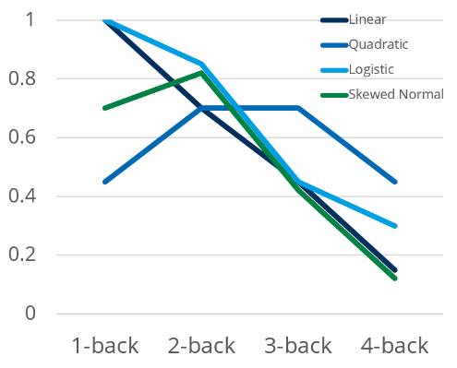
III. Analyses and Specification Curve Analysis
Manipulation check/Decreasing performance
d’ declines with n-back level
Reaction time increases with n-back level
NASA-TLX ratings increase with n-back level
Subjective values and performance
Subjective values decline with n-back level
…even after controlling for declining performance
Subjective values and Need for Cognition
Different subjective value curves depending on NFC
NASA-TLX ratings are lower for higher NFC
Different aversiveness curves depending on NFC
Repeated measures ANOVAs with paired linear contrasts
Repeated measures ANOVA with different contrasts
Linear or nonlinear multi level model

Slide 10
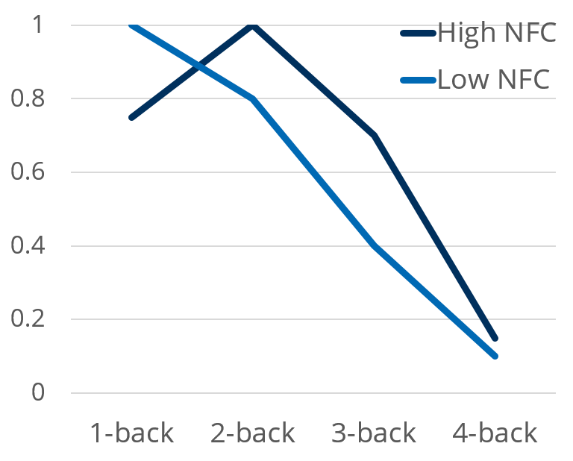
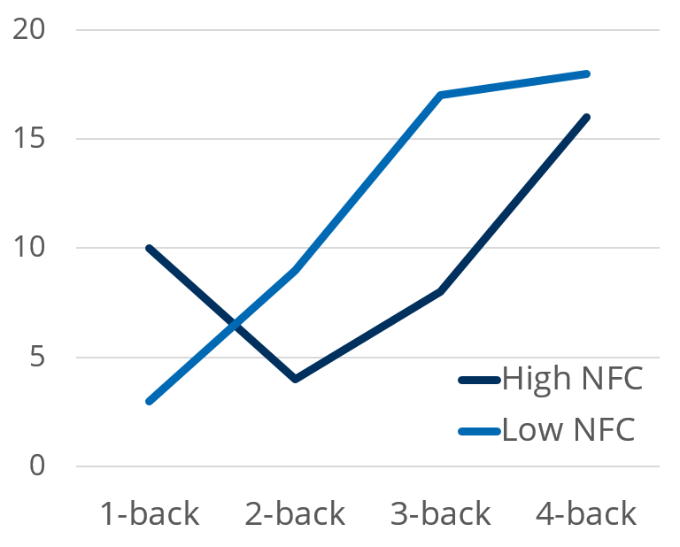
III. Analyses and Specification Curve Analysis
Manipulation check/Decreasing performance
d’ declines with n-back level
Reaction time increases with n-back level
NASA-TLX ratings increase with n-back level
Subjective values and performance
Subjective values decline with n-back level
…even after controlling for declining performance
Subjective values and Need for Cognition
Different subjective value curves depending on NFC
NASA-TLX ratings are lower for higher NFC
Different aversiveness curves depending on NFC
Subjective value
NASA-TLX score

Slide 11
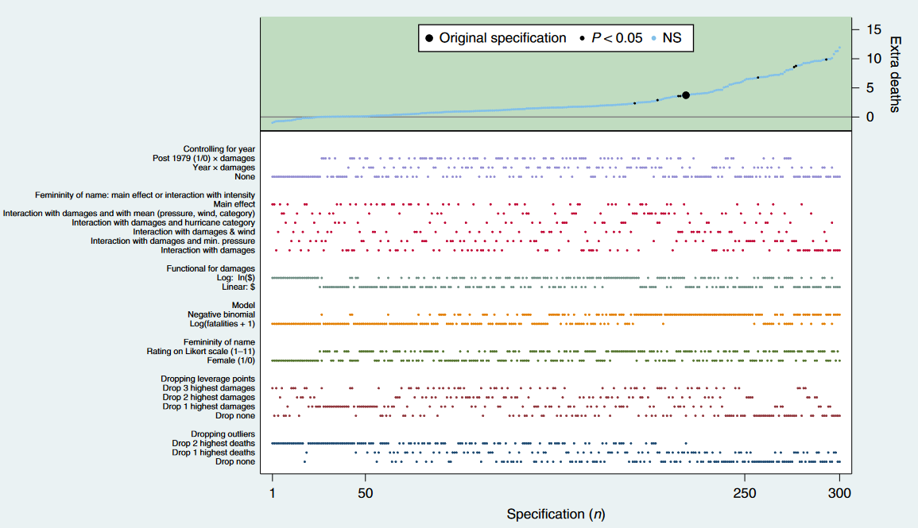
III. Analyses and Specification Curve Analysis
Data transformation:
None
Logarithmic
Inverse
Square-root
Outlier exclusion:
None
2 MAD from median
2.5 MAD from median
3 MAD from median
Reaction time < 100 ms
Reaction time < 200 ms
Dimension of application:
Across subjects, across levels
Across subjects, within levels
Within subjects, within levels
Within subjects, across levels
By Simonsohn et al. (2020)

Slide 12
References
Scheffel, C., Graupner, S.-T., Gärtner, A., Zerna, J., Strobel, A., & Dörfel, D. (2021). Effort beats effectiveness in emotion regulation choice: Differences between suppression and distancing in subjective and physiological measures. Psychophysiology, 58, e13908. https://doi.org/10.1111/psyp.13908
Simonsohn, U., Simmons, J.P. & Nelson, L.D. Specification curve analysis. Nat Hum Behav 4, 1208–1214 (2020). https://doi.org/10.1038/s41562-020-0912-z
Westbrook A, Kester D, Braver TS (2013) What Is the Subjective Cost of Cognitive Effort? Load, Trait, and Aging Effects Revealed by Economic Preference. PLoS ONE 8(7): e68210. https://doi.org/10.1371/journal.pone.0068210

